Slide 1
Recruitment and generation to generation models

Slide 2
Readings
Hilborn and Walters. Chapter 7
Myers, R. A., A. A. Rosenberg, P. M. Mace, N. Barrowman, and V. R. Restrepo. 1994. In search of thresholds for recruitment overfishing. ICES Journal of Marine Science. 51: 191-205.
Gilbert, D. J. 1997. Towards a new recruitment paradigm for fish stocks. Can. J. Fish. Aquat. Sci. 54: 969-977.

Slide 3
Applications
Fish: semelparous species spawners to adults
Fish: recruitment of age 1
Mammals/Birds: recruitment of age 1
Insects: univoltine or other generation to generation models
Annual plants

Slide 4
The recruitment process
We usually define “recruitment” as the age or size where we first detect the individuals with whatever technology we employ
R(t) = f(N(t-L))
Basic elements, fecundity and survival

Slide 5
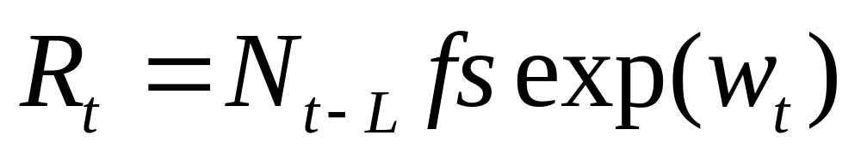
If no density dependence
Recruitment = numbers times fecundity times survival times environmental variability
Demo with spawner recruit simulation

Slide 6
There must be density dependence
Otherwise the population would grow exponentially or decline to extinction
This may not be true within poor habitats, especially in meta population models
But in the poor habitats the population is maintained by immigration and this is density dependent

Slide 7
Mechanistic explanation
unlimited habitat
strict territoriality
random egg deposition
gradations in habitat quality

Slide 8
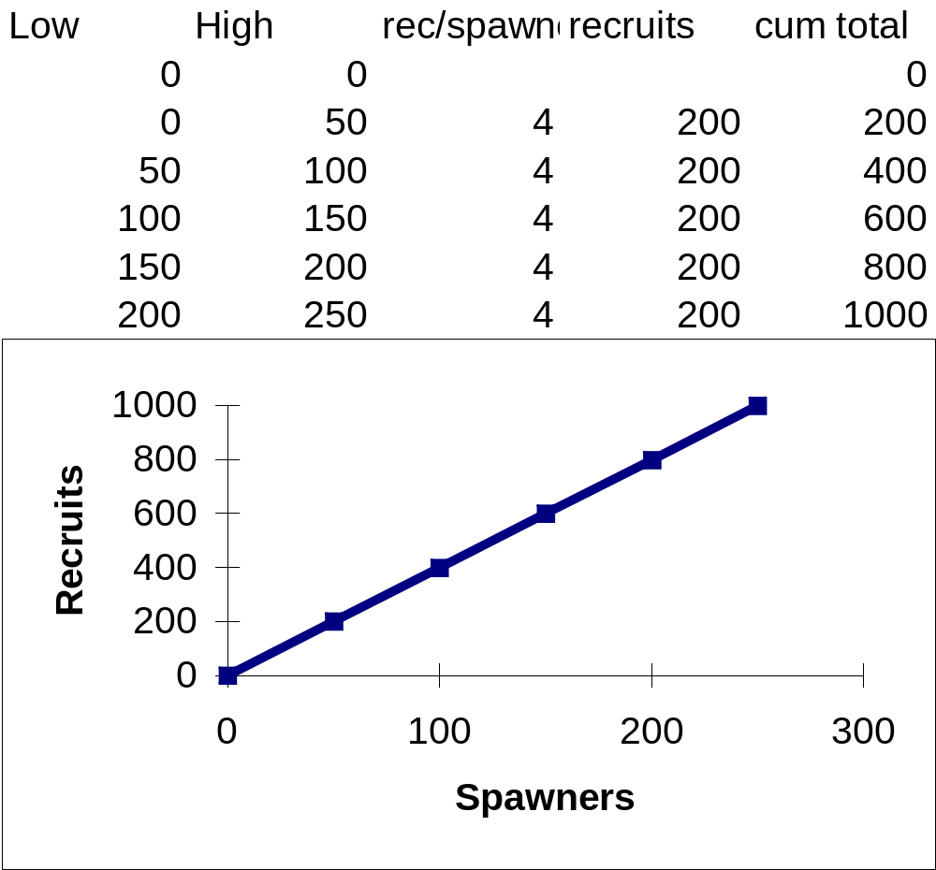
Unlimited habitat

Slide 9
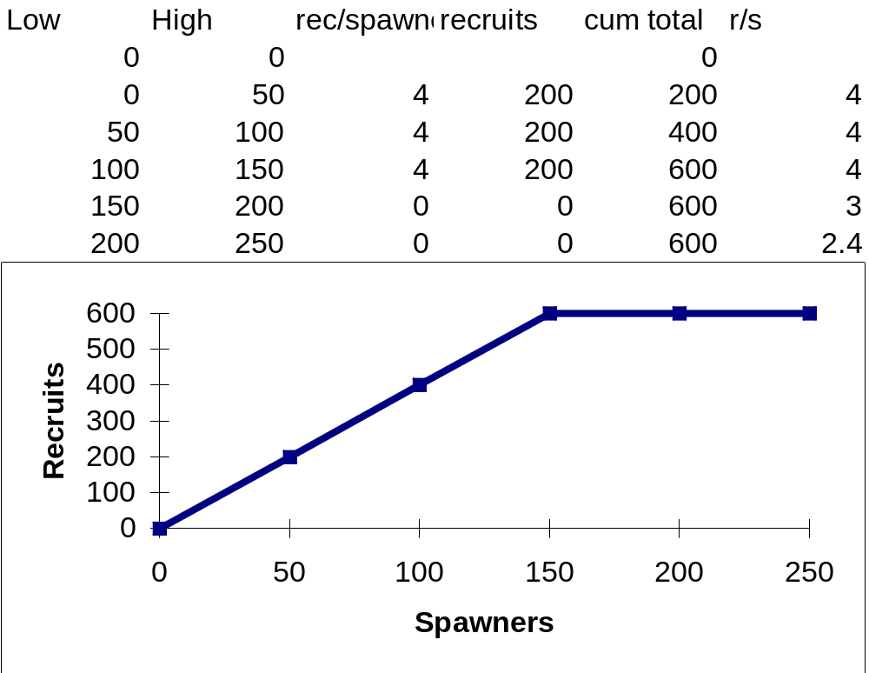
Strict territoriality

Slide 10
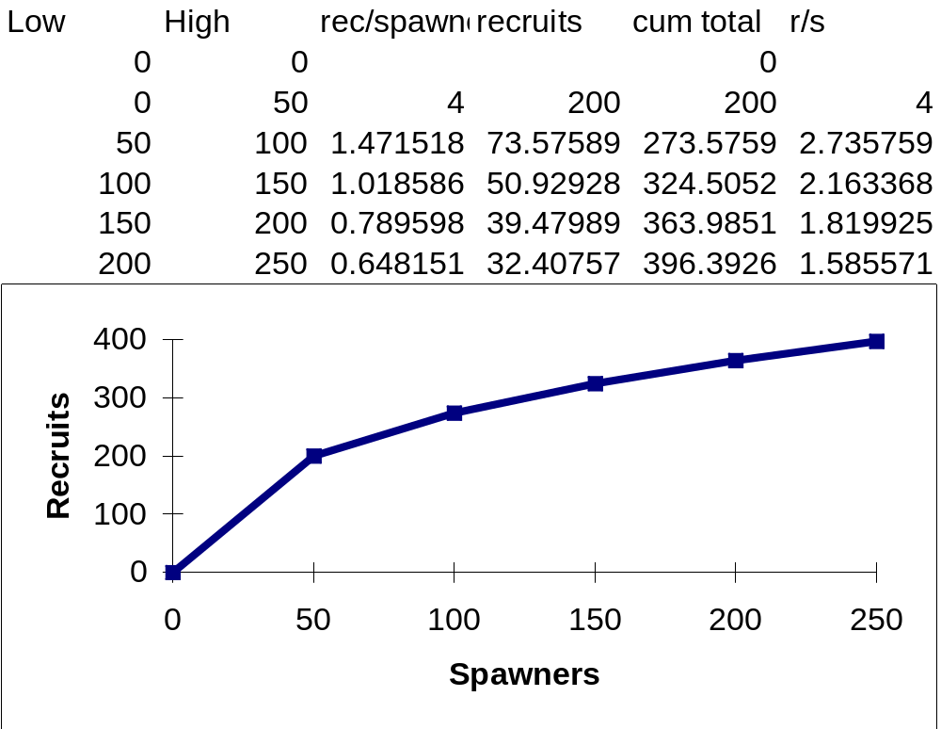
Random egg deposition

Slide 11
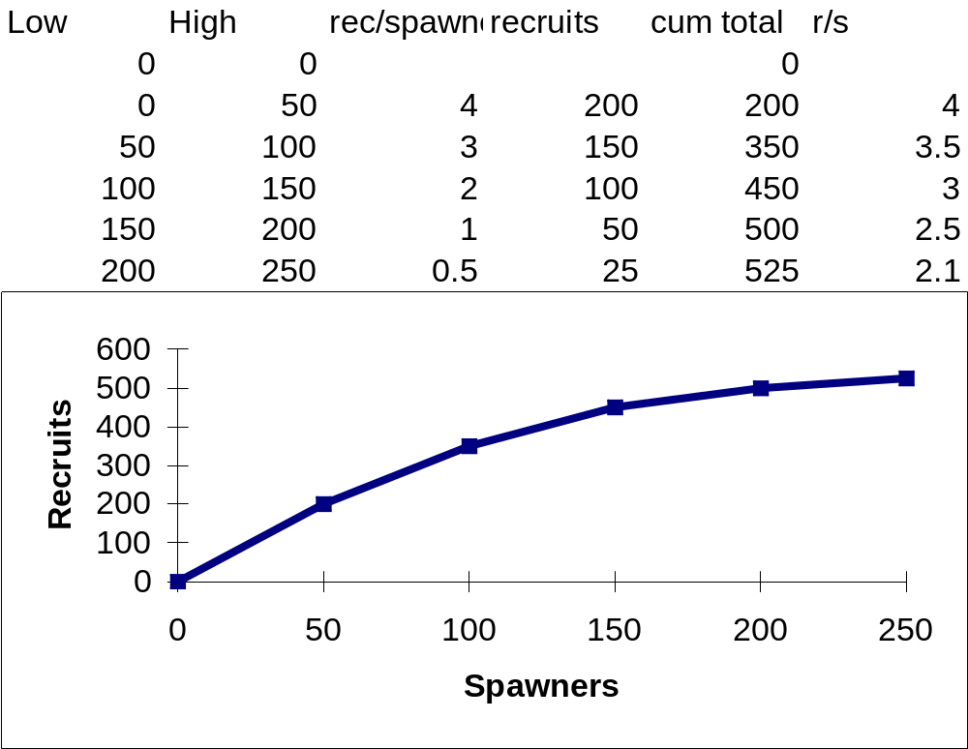
Habitat gradations

Slide 12
Risk Sensitive Foraging
The world is full of food, not because everyone gets enough to eat, but because predation risk keeps individuals from feeding as much as they would like
Animals in micro habitats well protected from predators will be the ones to feed enough to survive

Slide 13
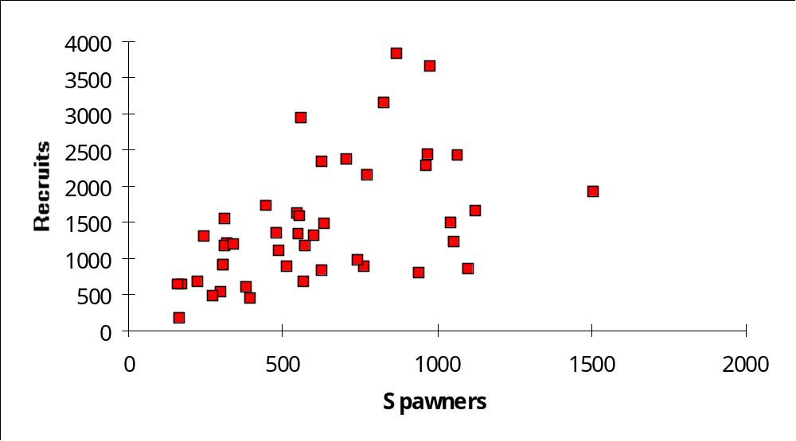
Observed relationships Skeena sockeye

Slide 14
Key features
General increase in average recruitment with higher spawning stock
Higher variance with higher spawning stock size
General smoothness of underlying curve

Slide 15
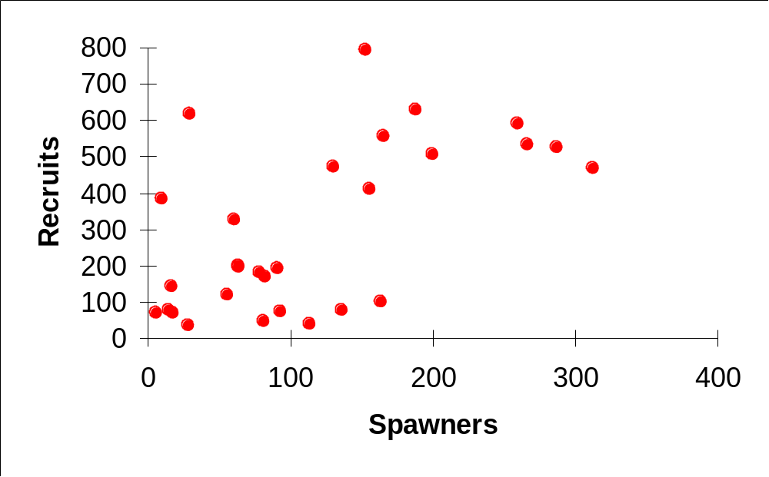
Icelandic summer spawning herring

Slide 16
Other examples
Sinclair’s sterilized rabbits
The baby boom of the 40’s and 50’s

Slide 17
Modeling recruitment

Slide 18
Principles
Continuity: no sharp jumps
Stationarity: shape of curve doesn’t change over time

Slide 19
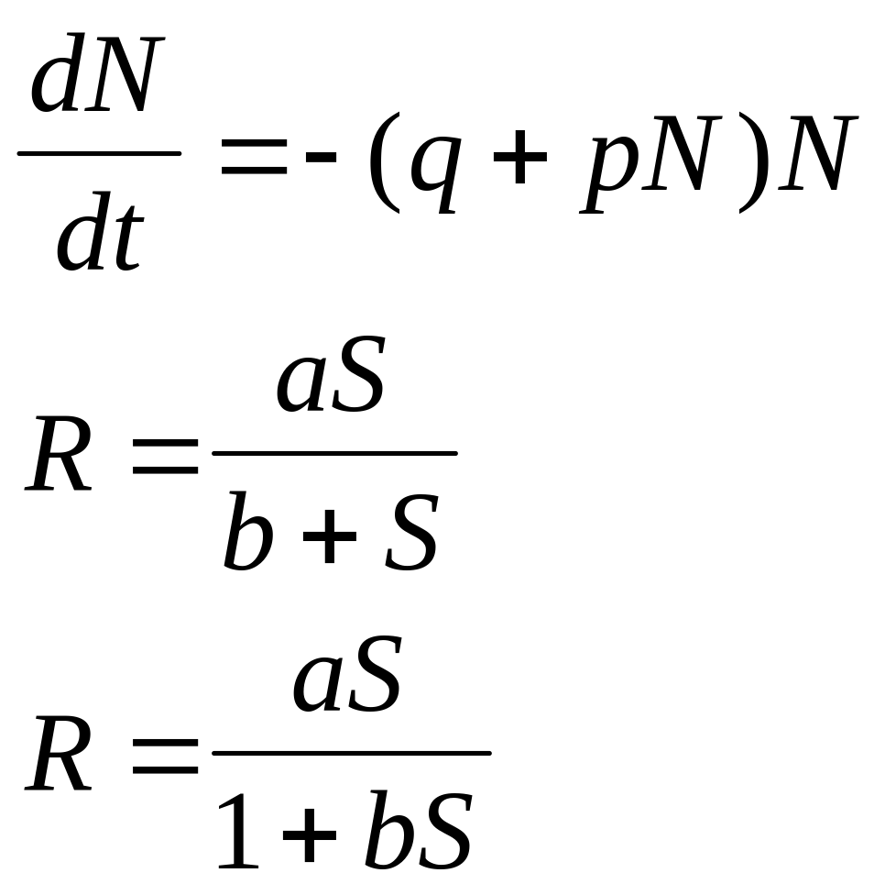
Beverton Holt curve

Slide 20
Key assumptions of BH
Survival depends upon the density of the cohort at any time
  Continued competition for food or other resources over the whole life history
cohort simulation.xls

Slide 21
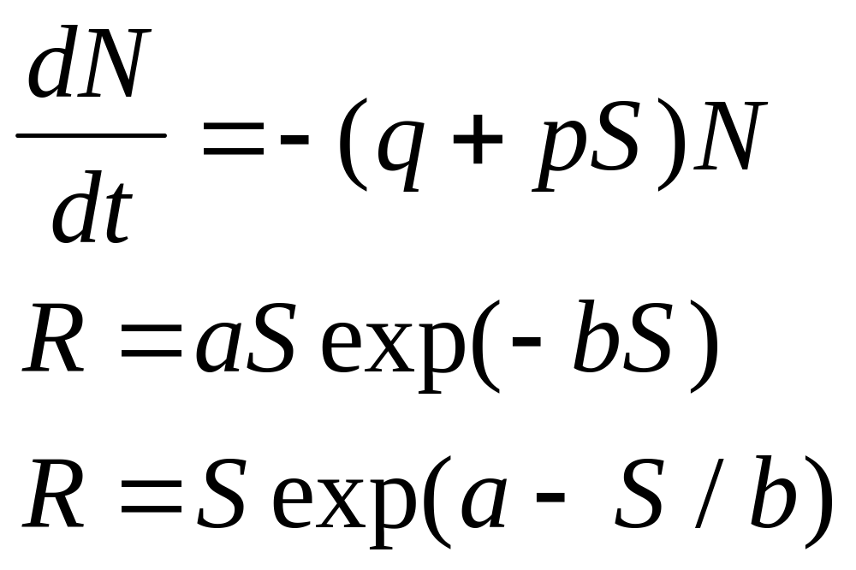
Ricker’s model

Slide 22
Ricker assumption
Survival depends on initial cohort size
  Due to disease transmission at time of spawning for example

Slide 23
Another approach to describing recruitment
Calculate average recruitment over different ranges of spawners
This is a “non parametric” approach and totally empirical

Slide 24
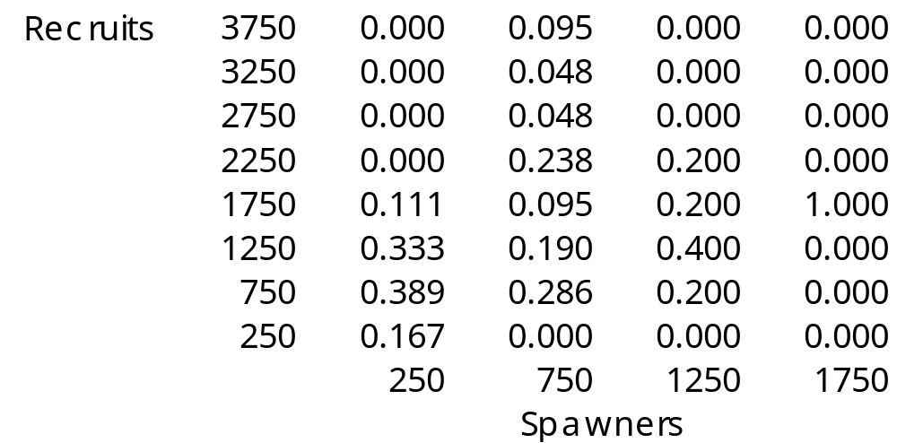
Markov Skeena Sockeye

Slide 25
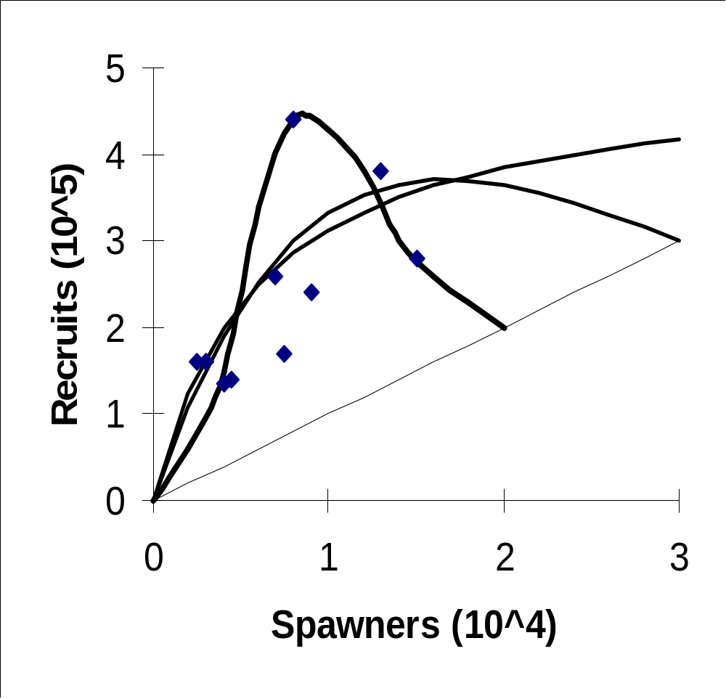
Lizard fish

Slide 26
Lessons from lizard fish
Don’t trust your eye
Since these fish are not semelparous, the y=x line is illusory

Slide 27
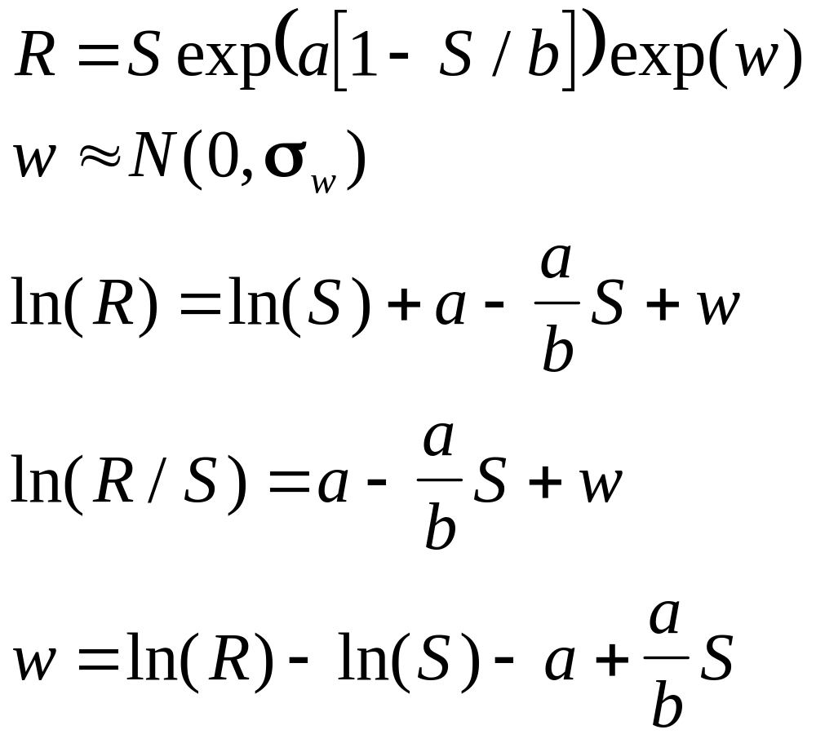
Process error estimation

Slide 28
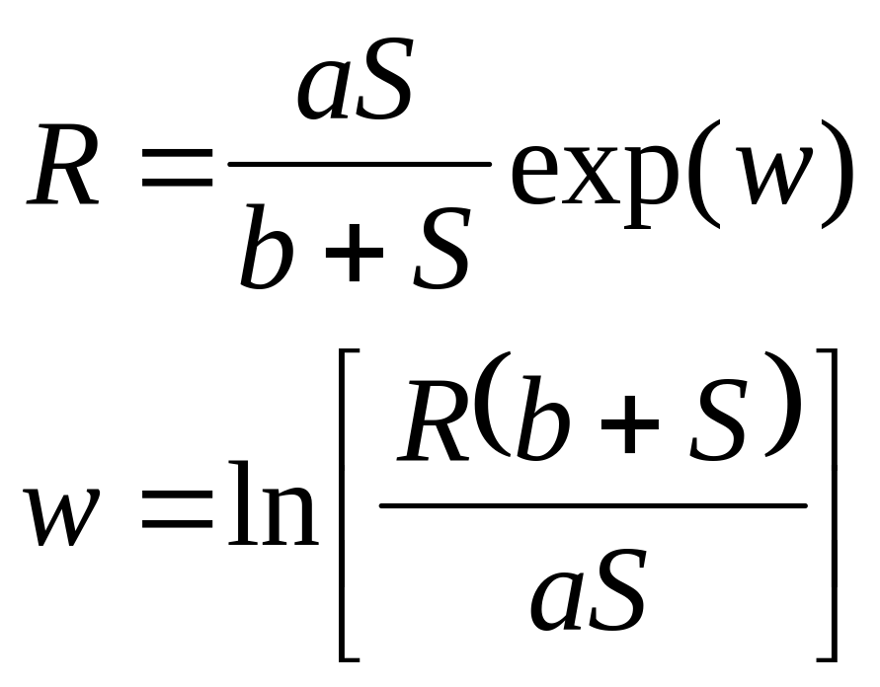
Process error
Beverton-Holt

Slide 29
Simulation of estimation
Mixture of process error (sigma w)
And observation error (sigma v)
Also impacted by contrast in x

Slide 30
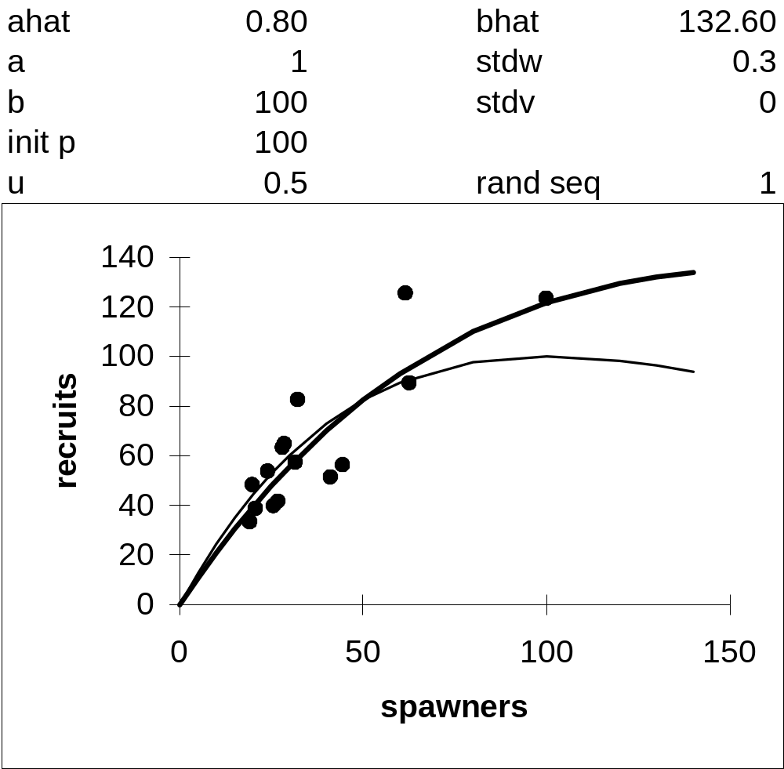
Ricker fitting Monte-Carlo

Slide 31
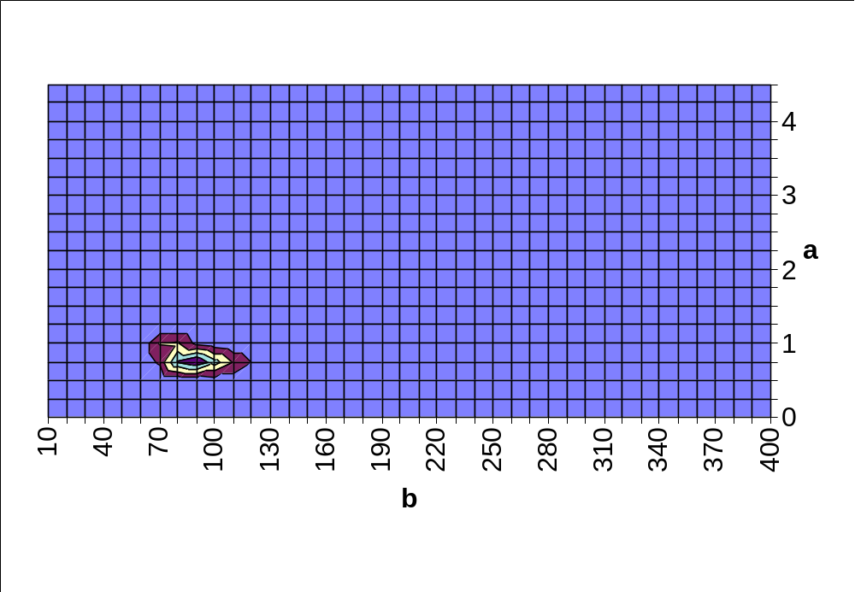
Ricker likelihood profile

Slide 32
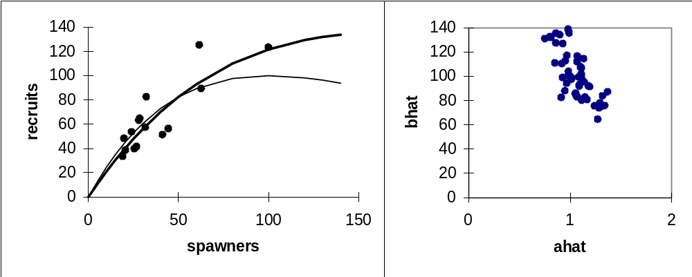
52 Monte carlo reps

Slide 33
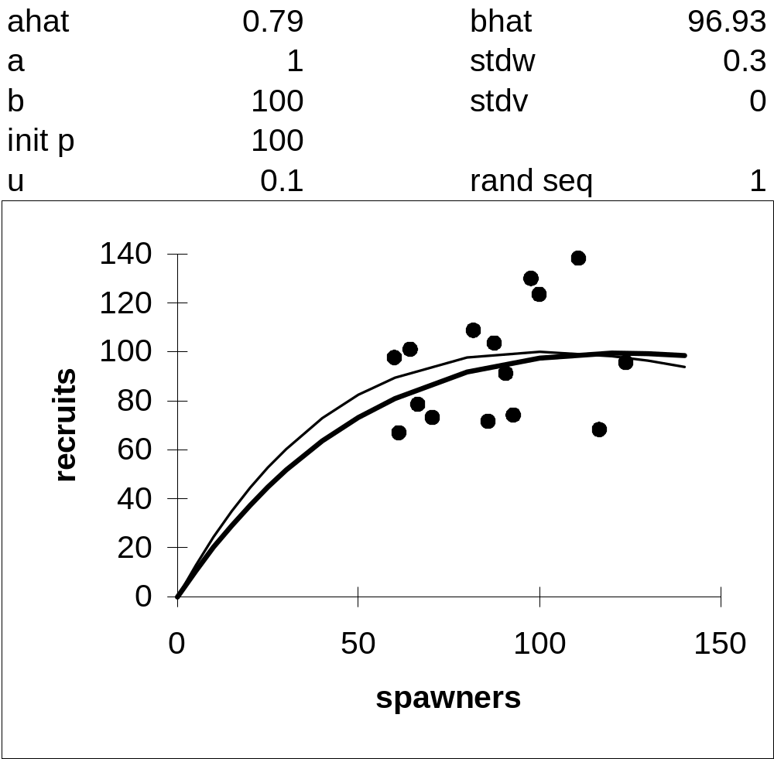
Less contrast

Slide 34
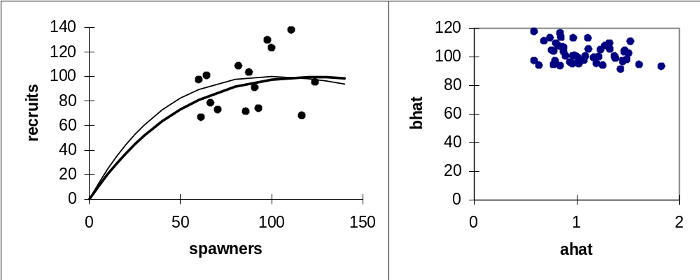
Less contrast, high stock

Slide 35
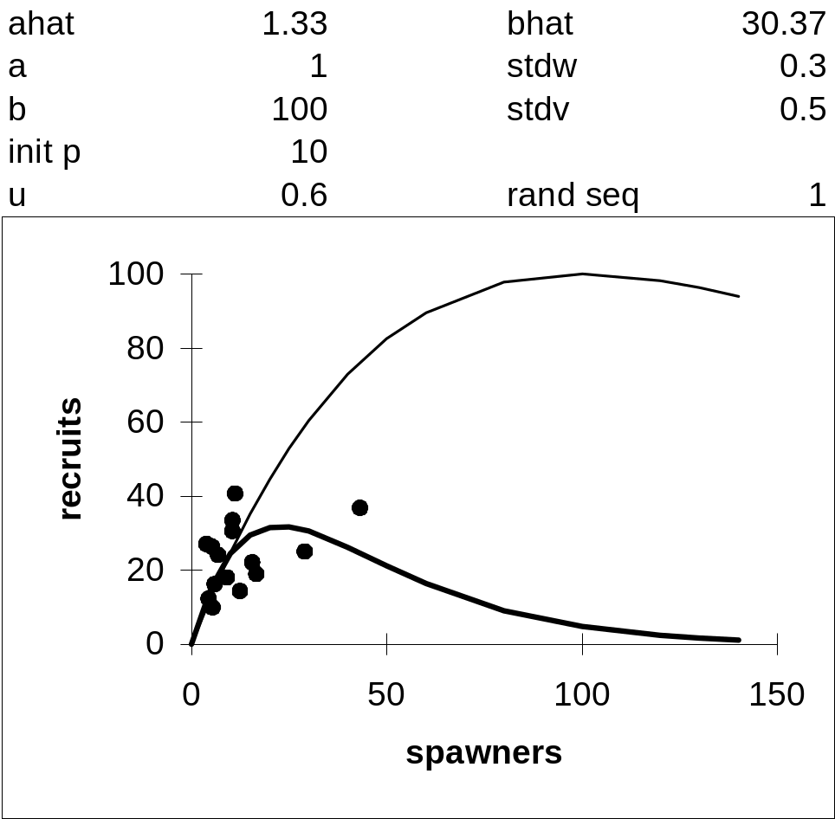
Error in observations

Slide 36
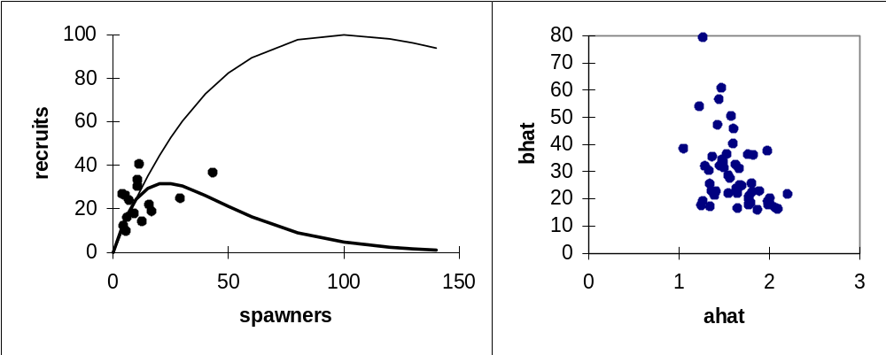
Errors in observations

Slide 37
Final Points
Contrast is important
Bias induced by time series
Bias induced by errors in observations
Serial autocorrelation of residuals
How to determine if environment is the cause?

Slide 38
Gilbert’s hypothesis
Recruits generate spawners
Growing recognition that environmental changes are important determinants of recruitment
  If you move from a high productive regime to a low one, then recruitment will decline, you will have two kinds of data, large recruitment and large spawning stock, and low recruitment low spawning stock

Slide 39
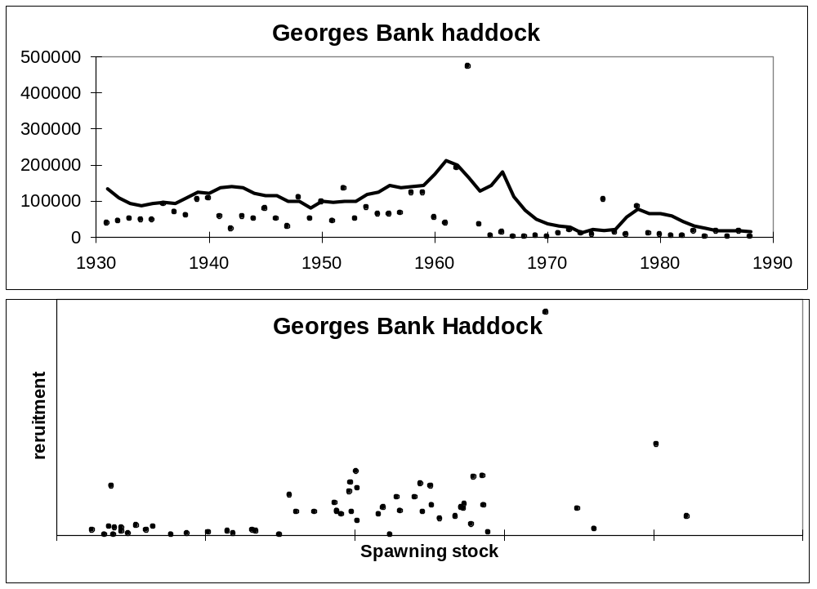

Slide 40
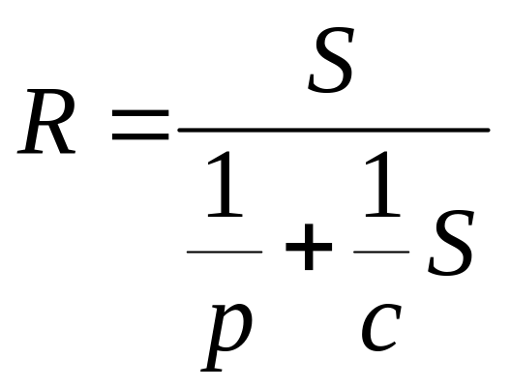
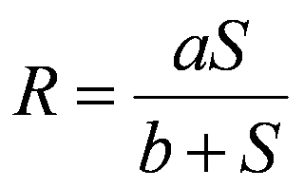
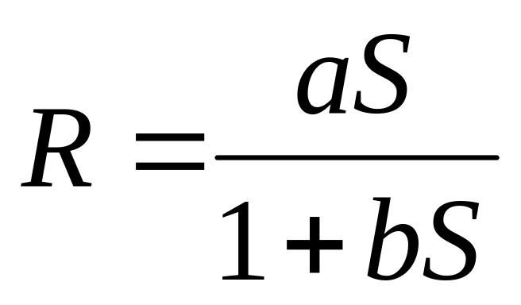
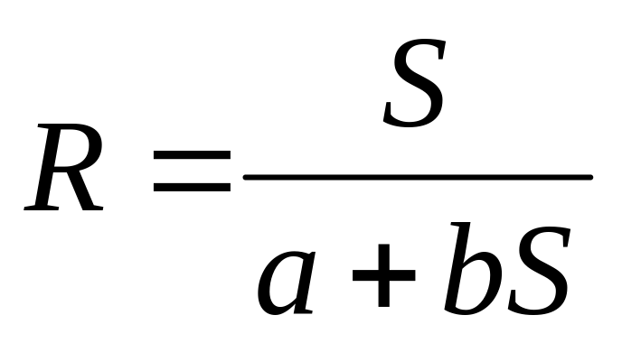
Forms of the Beverton Holt

Slide 41
The biological interpretation of parameters
Make S approach infinity
Make S approach 0

